Slide 1
Perspective Matrix and its implementation
Sang Il Park

Slide 2
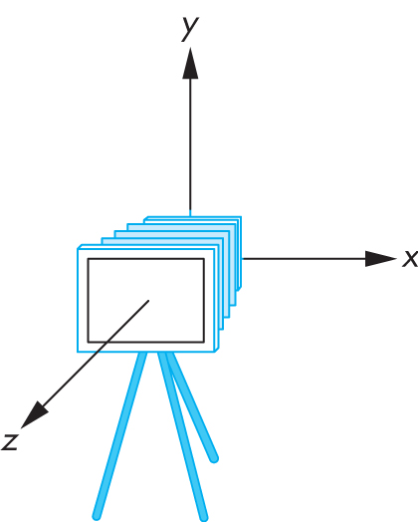
Review : Viewing in OpenGL
Remember: camera is pointing in the negative z direction

Slide 3
Review : Translate + Rotation
Cx
Cz
eye
Cx
at
Cz
R_{c}
T_{c}=translate(-eye)
eye
Wx
at
Wz

Slide 4
Review : Think about inverse transform
Cx
Cz
eye
R_{c}=(R_{w})⁻¹
Wx
at
=(R_{w})^{T}
Wz
R_{w}
Wx
Wz

Slide 5
Review : Summary of Rotation
gluLookAt (ex,ey,ez, fx,fy,fz, ux,uy,uz);
n = (f – e) / |f – e|
v = (u – (u · n) n) / |u – (u · n) n|
w = n x v
Rotation must map:
(1,0,0) to w
(0,1,0) to v
(0,0,-1) to n
Cy
v
n
Cz
e
f
Cx
w
Camera plane

Slide 6
Review : Putting All Together
Calculate V = R_{w}⁻¹ T_{w}⁻¹
This is different from book [Angel, Ch. 4.3.2]
There, u, v, n are right-handed (here: u, v, -n)

Slide 7
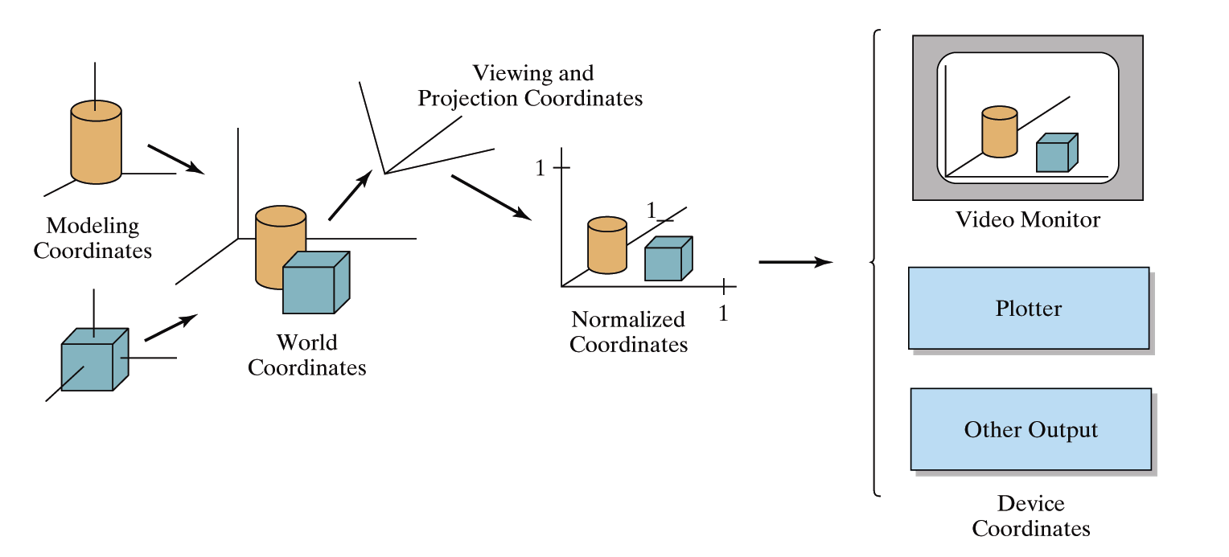
OpenGL Geometric Transformations (old style)
glMatrixMode(GL_MODELVIEW);

Slide 8
Projection Matrix and its implementation

Slide 9
Topics
Simple Parallel Projections
Simple Perspective Projections

Slide 10
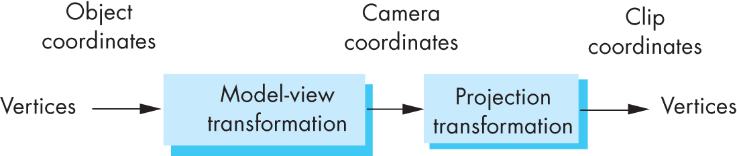
Projection Matrices
Recall geometric pipeline
Projection takes 3D to 2D
Projections are not invertible
Projections also described by 4x4 matrix
Homogenous coordinates crucial
Parallel and perspective projections

Slide 11
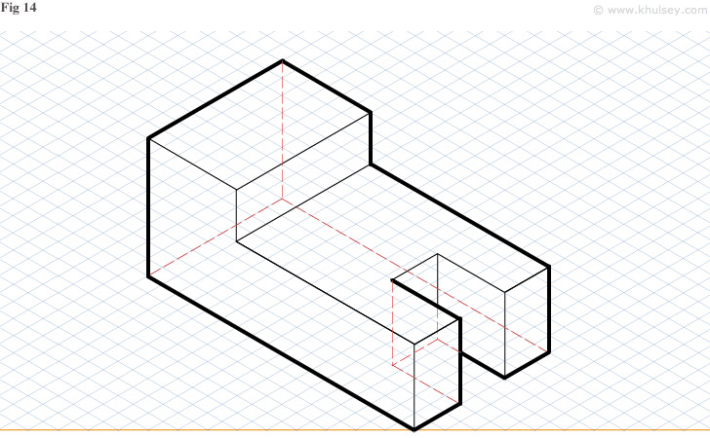
Simple Parallel Projection

Slide 12
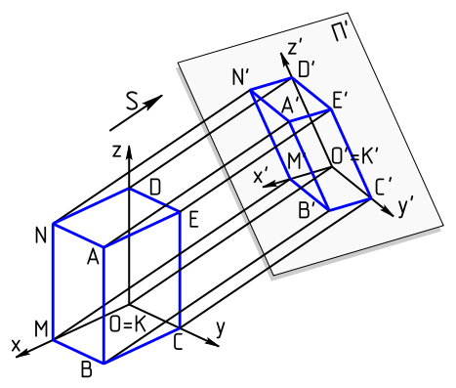
Parallel Projection
Project 3D object to 2D via parallel lines
The lines are not necessarily orthogonal to projection plane

Slide 13
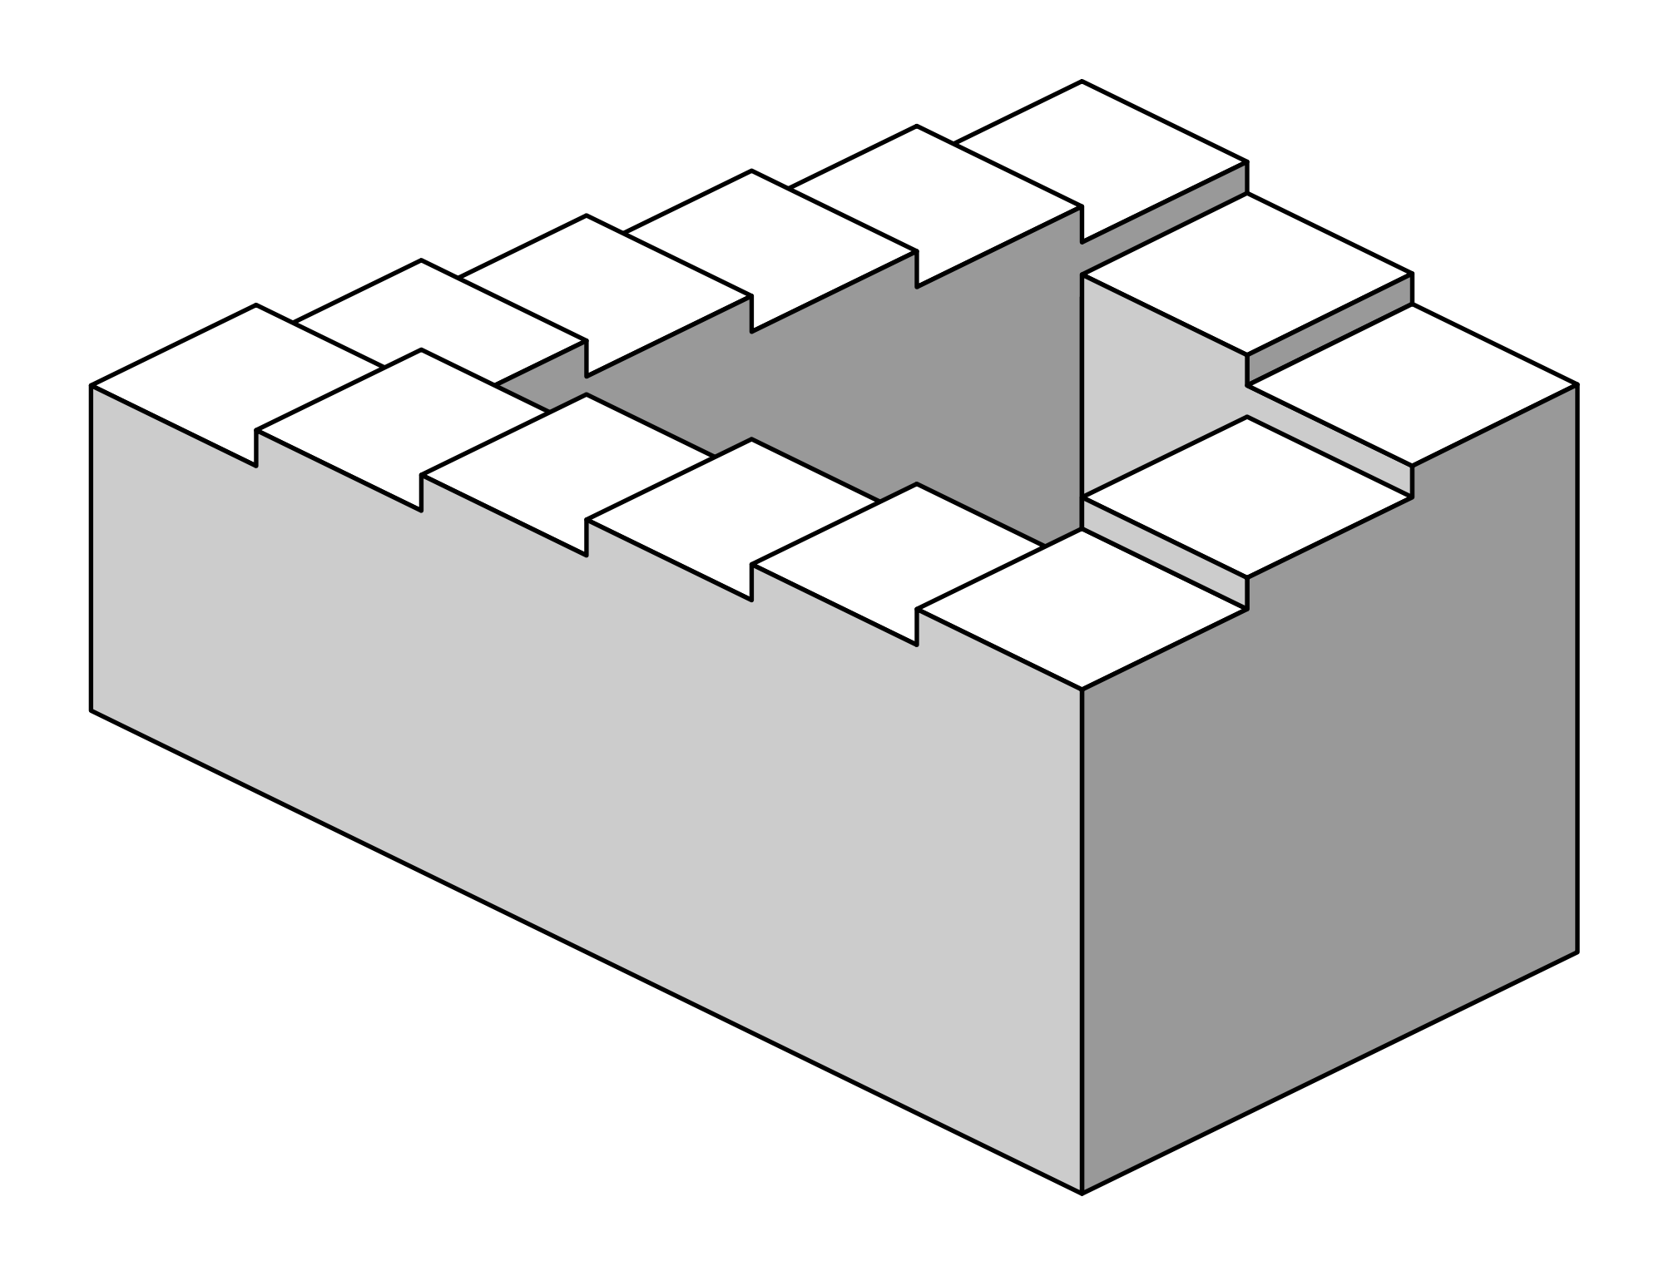
Parallel Projection
Problem: objects far away do not appear smaller
Can lead to “impossible objects” :
Echochrome: https://www.youtube.com/watch?v=QfICeBtVv8U
Penrose stairs

Slide 14
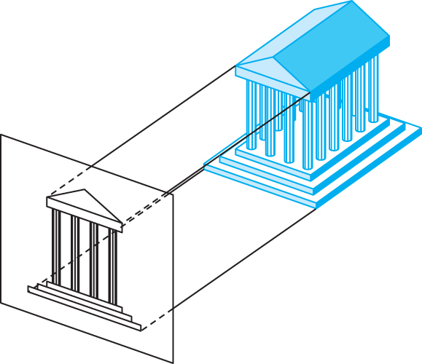

Orthographic Projection
A special kind of parallel projection: projectors perpendicular to projection plane
Simple, but not realistic
Used in blueprints (multiview projections)

Slide 15
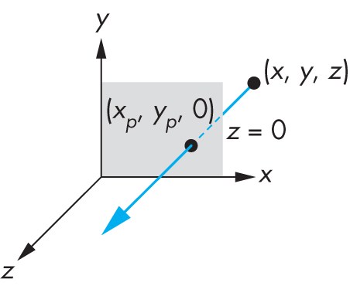
Simple Orthographic Projection Matrix
Project onto z = 0
x_{p} = x, y_{p} = y, z_{p} = 0
In homogenous coordinates

Slide 16
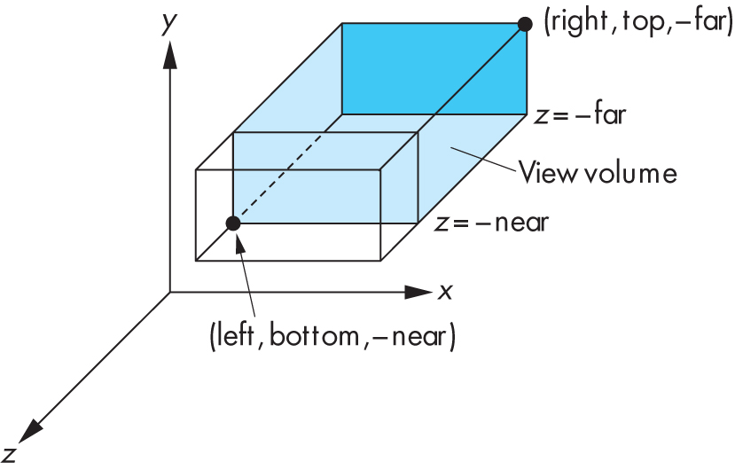
Orthographic Viewing in Old OpenGL
glOrtho(xmin, xmax, ymin, ymax, near, far)

Slide 17
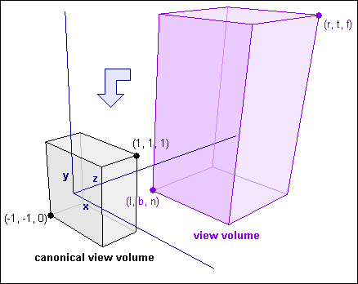
The Normalized view volume
How exactly do we take contents of an arbitrary view volume and project them to a 2D surface?
Arbitrary view volume is too complex…
Reduce it to a simpler problem! The Normalized view volume!
Can also be called the standard or unit or canonical view volume

Slide 18
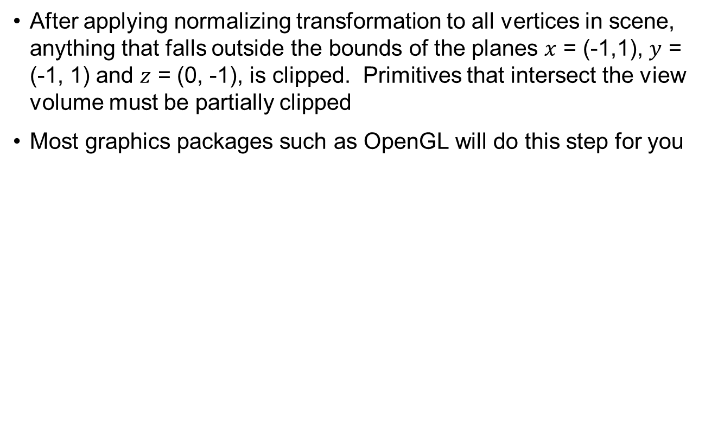
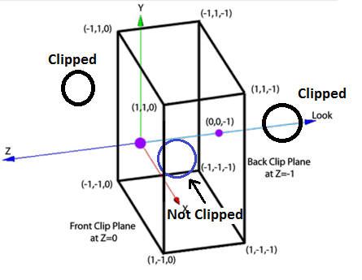
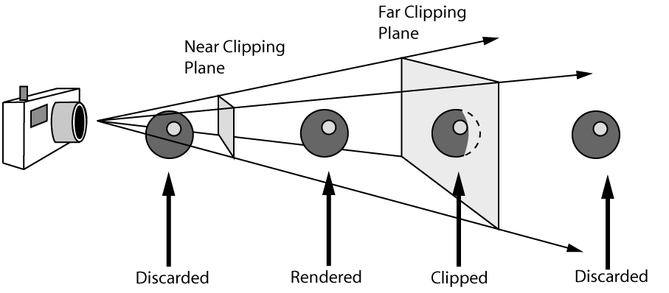
Clipping against the normalized view volume

Slide 19
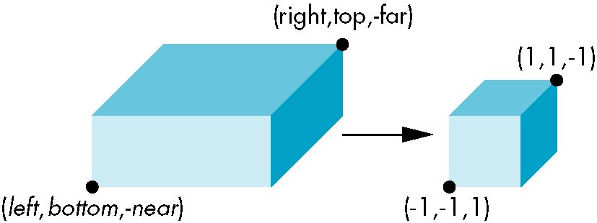
Orthogonal Normalization I
Ortho(left,right,bottom,top,near,far)
normalization ⇒ find transformation to convert
specified clipping volume to default

Slide 20
Orthogonal Matrix I
Two steps
Move center to origin
T(-(left+right)/2, -(bottom+top)/2, (near+far)/2)
Scale to have sides of length 2
S(2/(left-right),2/(top-bottom),2/(far-near))
P = ST =

Slide 21
Orthogonal Normalization II
Ortho(left,right,bottom,top,near,far)
normalization ⇒ find transformation to convert
specified clipping volume to default
0

Slide 22
Orthogonal Matrix II
Two steps
Move center to origin
Translate(-(left+right)/2, -(bottom+top)/2, near)
Scale to have sides of length 2 for x, y, and length 1 for z
Scale(2/(left-right),2/(top-bottom),1/(far-near))
P = ST =

Slide 23
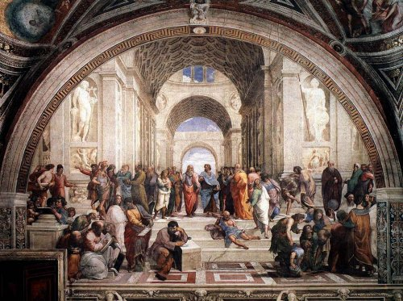
Perspective Projection

Slide 24
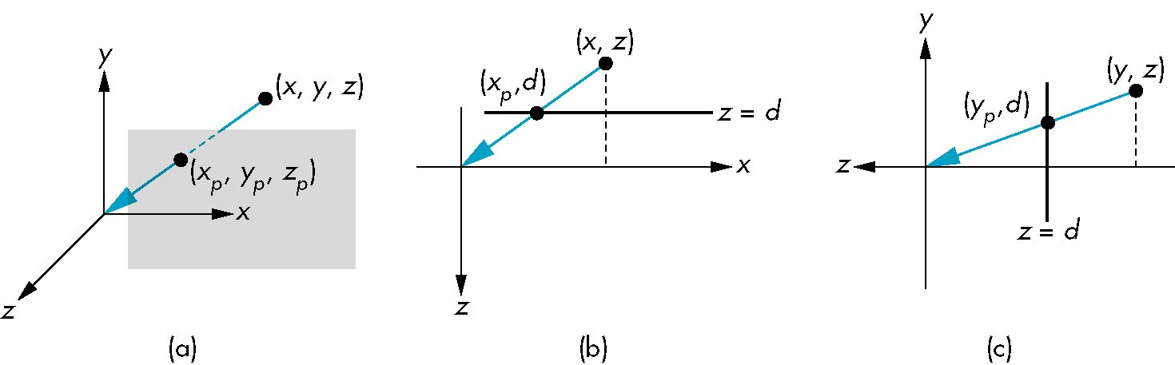
Simple Perspective
Center of projection at the origin
Projection plane z = d, d < 0

Slide 25
Perspective Equations
Consider top and side views
x_{p} =
y_{p} =
z_{p} = d

Slide 26
Homogeneous Coordinate Form
consider q = Mp where
M =
p =
⇒ q =

Slide 27
Perspective Division
However w ≠ 1, so we must divide by w to return from homogeneous coordinates
This perspective division yields
the desired perspective equations
x_{p} =
y_{p} =
z_{p} = d

Slide 28
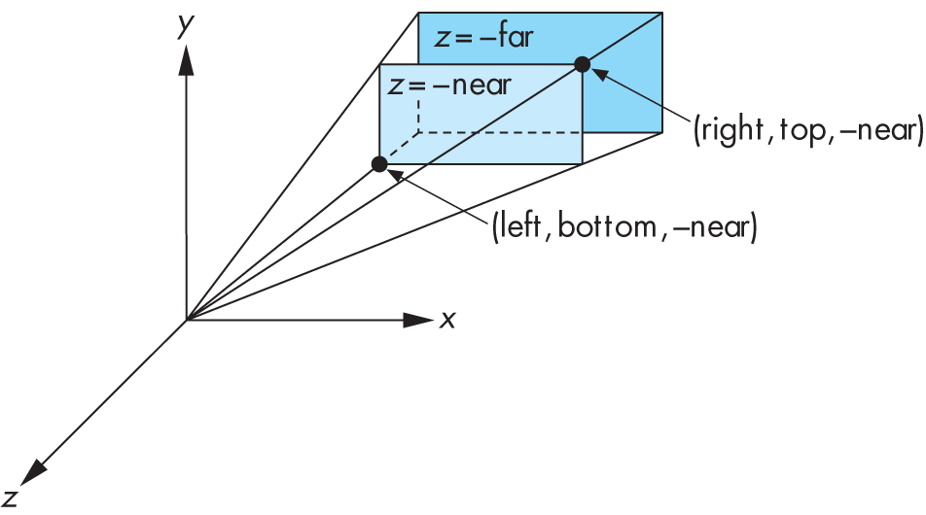
Perspective Viewing in Old OpenGL
Two interfaces: glFrustum and gluPerspective
glFrustum(xmin, xmax, ymin, ymax, near, far);

Slide 29
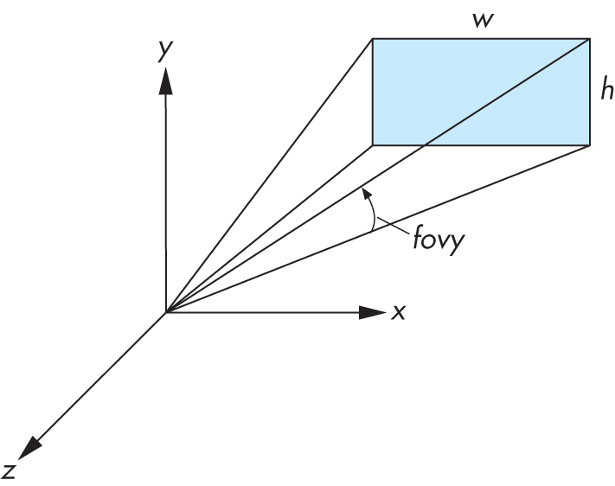
Field of View Interface in Old OpenGL
gluPerspective(fovy, aspectRatio, near, far);
aspectRatio = w / h
fovy specifies field of view as height (y) angle

Slide 30
Old OpenGL code
void reshape(int x, int y)
{
glViewport(0, 0, x, y);
glMatrixMode(GL_PROJECTION);
glLoadIdentity();
gluPerspective(60.0, x/float(y), 0.01, 10.0);
}

Slide 31
Implementing your own Frustum Function
glFrustum(xmin,xmax, ymin,ymax, near,far);
gluPerspective(fovy,aspectRatio, near,far);

Slide 32




The Perspective View Volume
Canonical view volume (frustum):
Far clipping plane
(-1,1,-1)
Near clipping plane
(1,-1,-1)

Slide 33

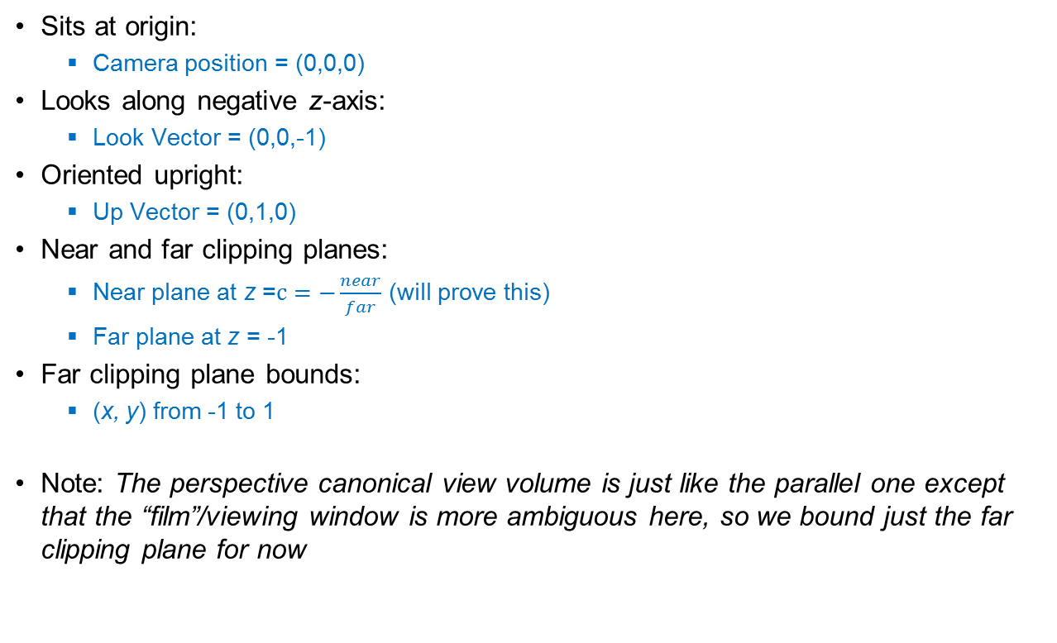



Properties of the canonical view volume
Far clipping plane
(-1,1,-1)
Near clipping plane

Slide 34
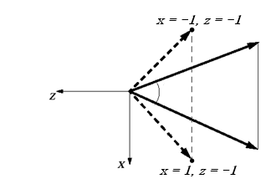
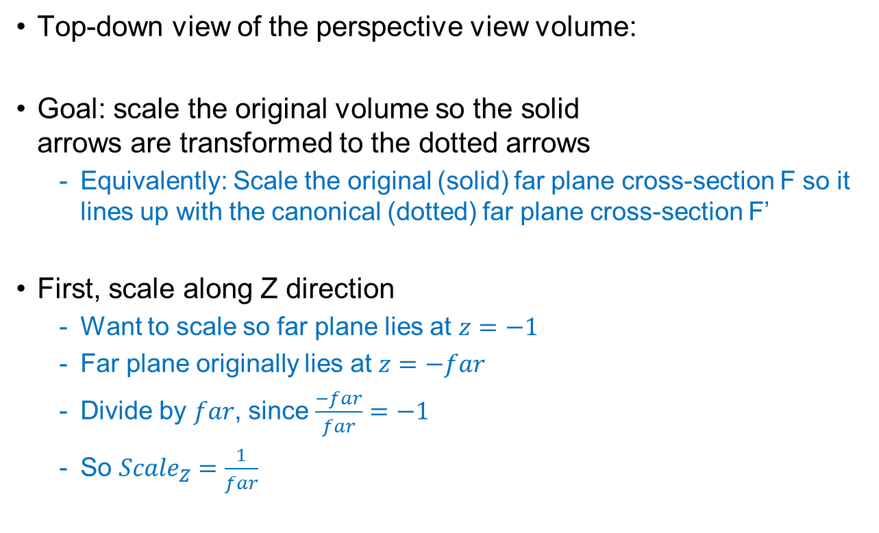
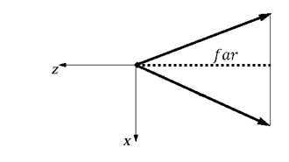
Scaling the perspective view volume (1/4)
F’
F

Slide 35
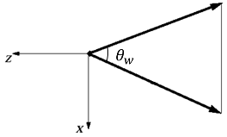
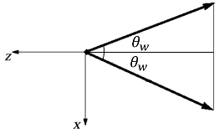


Scaling the perspective view volume (2/4)
Next, scale along X direction
Use the same trick: divide by size of volume along the X axis
How long is the side of the volume along X? Find out using trig…
Start with the original volume
Cut in half along the Z axis

Slide 36
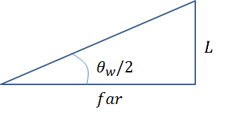
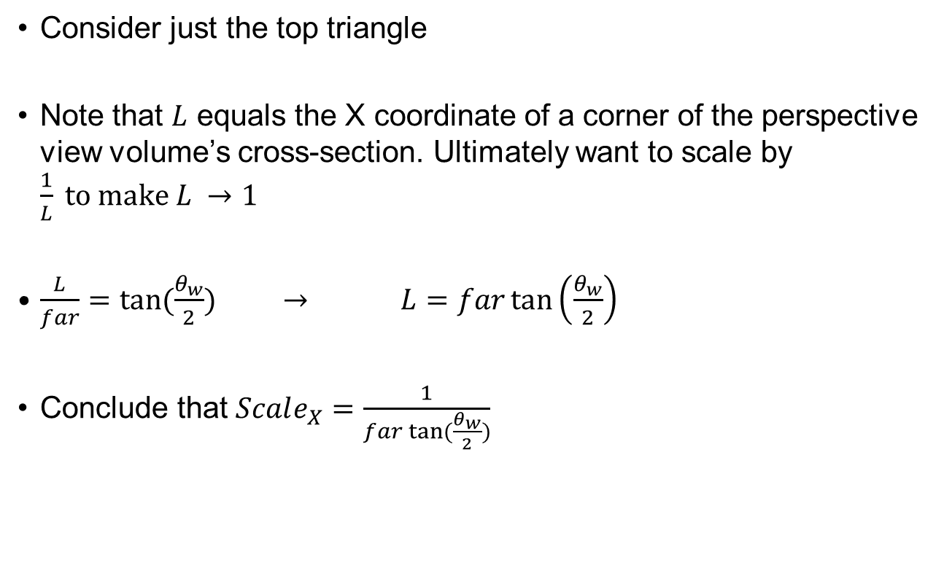
Scaling the perspective view volume (3/4)

Slide 37
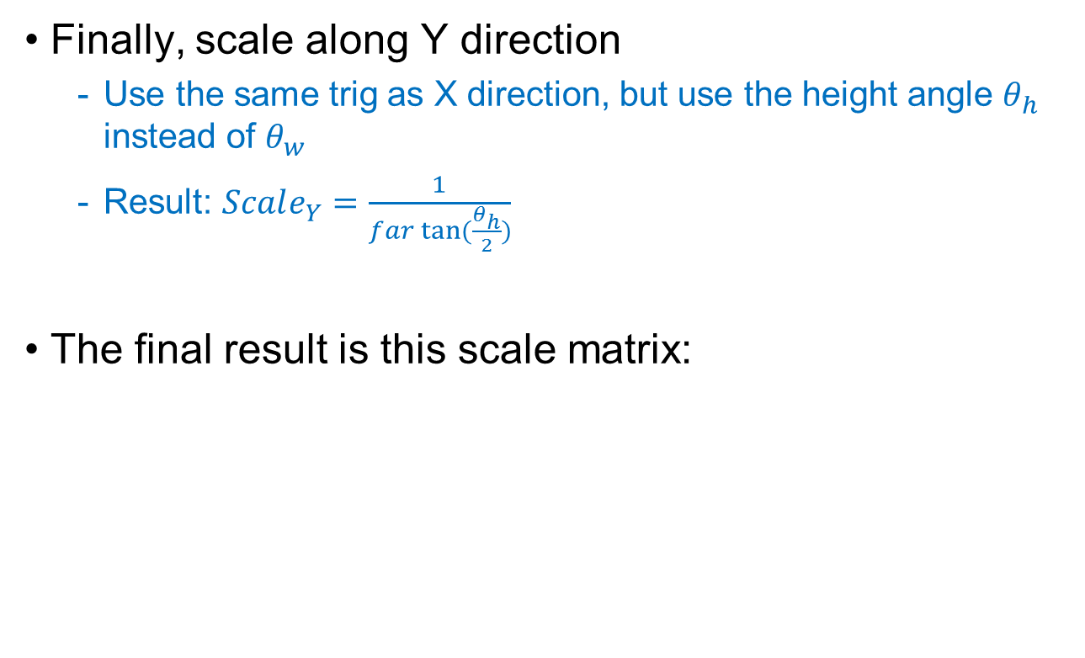
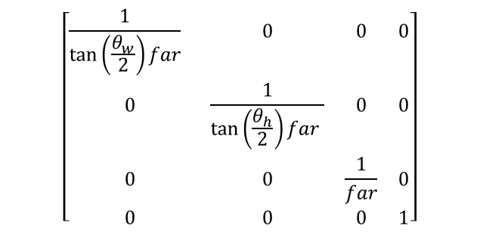
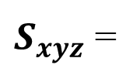
Scaling the perspective view volume (4/4)

Slide 38
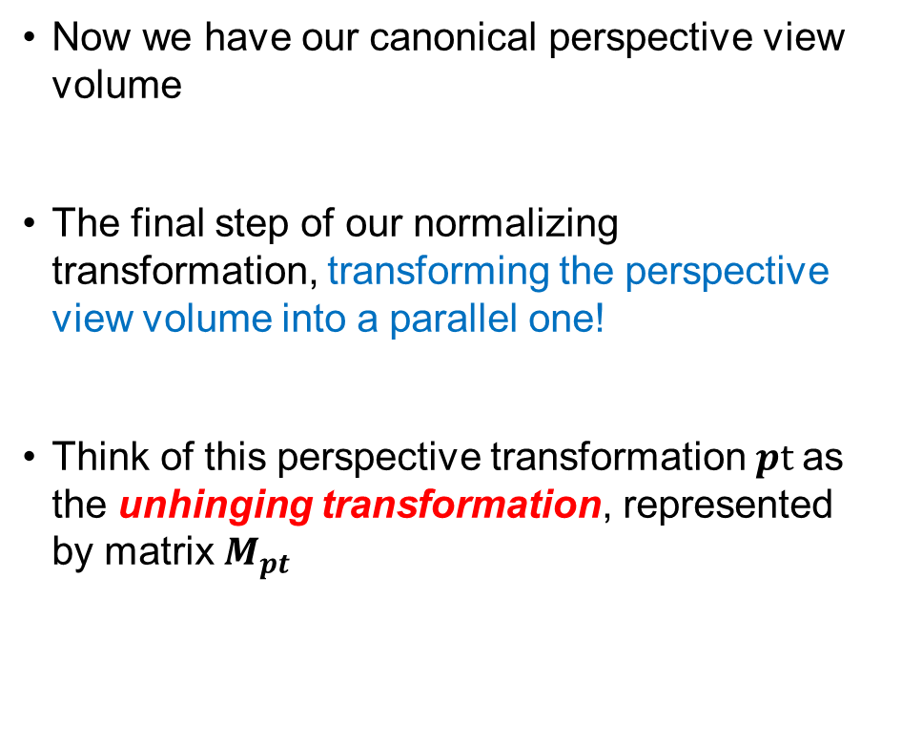
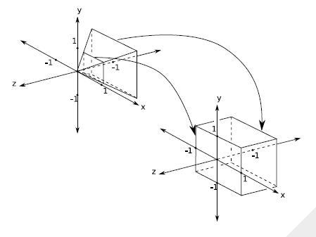
Perspective and Projection

Slide 39
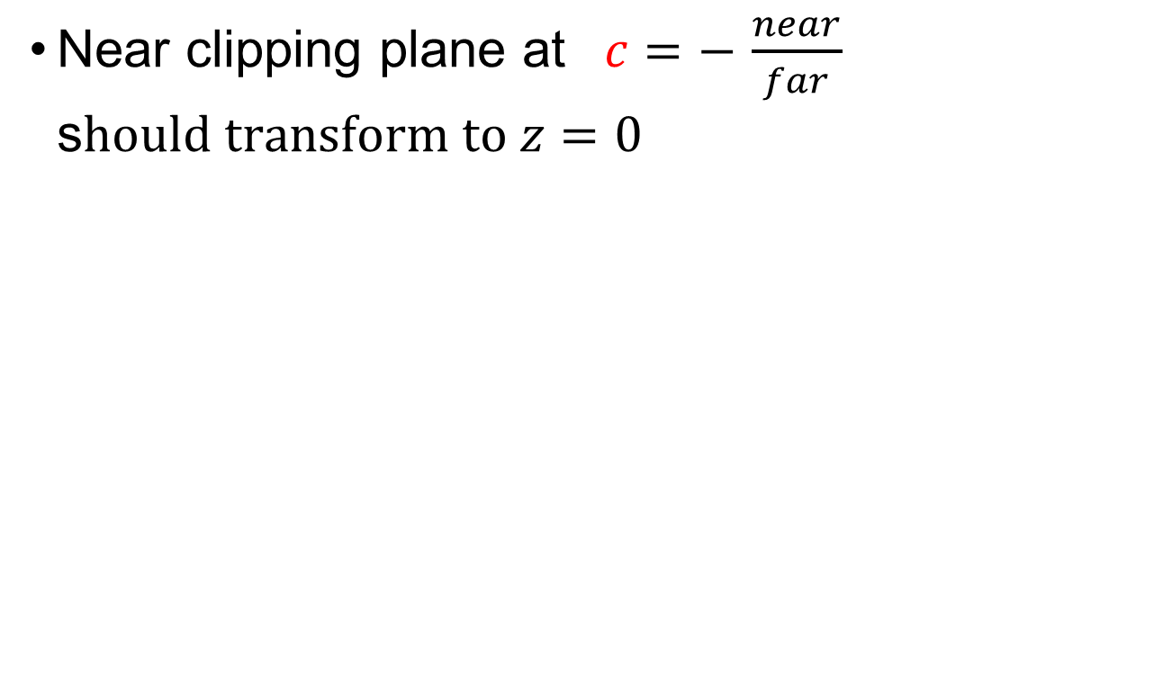




Unhinging View Volume to Become a Parallel View Volume (1/4)
-z

Slide 40
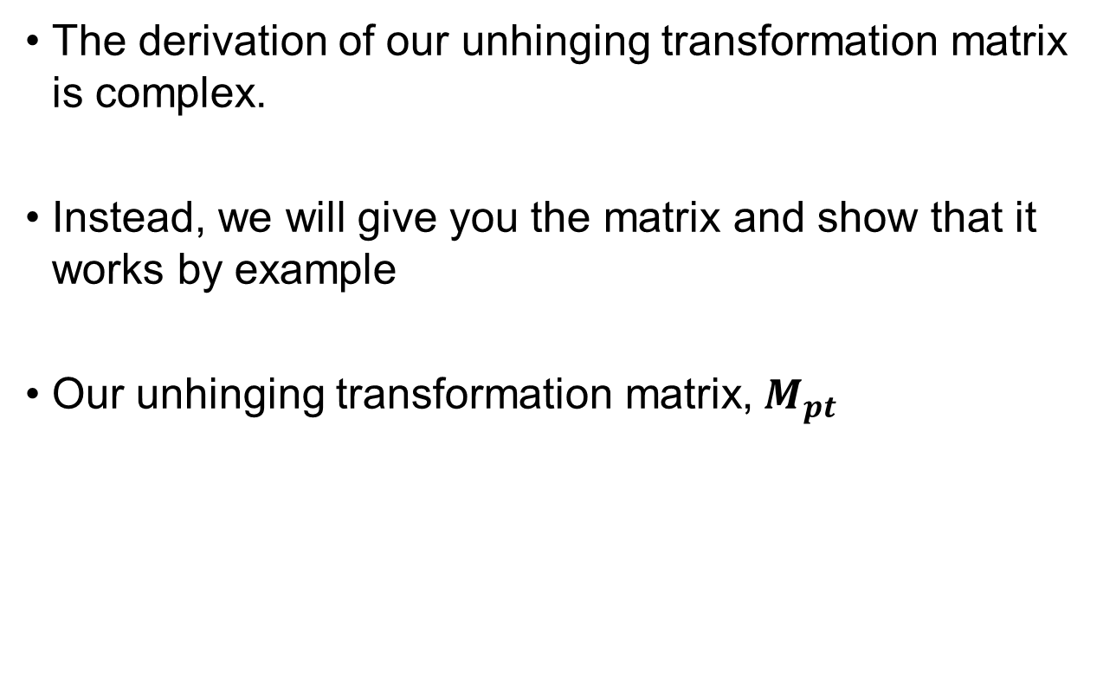

Unhinging View Volume to Become a Parallel View Volume(2/4)
$$\left[\begin{matrix}1 & 0 & 0 & 0 \\ 0 & 1 & 0 & 0 \\ 0 & 0 & \frac{1}{c+1} & \frac{−c}{c+1} \\ 0 & 0 & −1 & 0\end{matrix}\right]$$

Slide 41
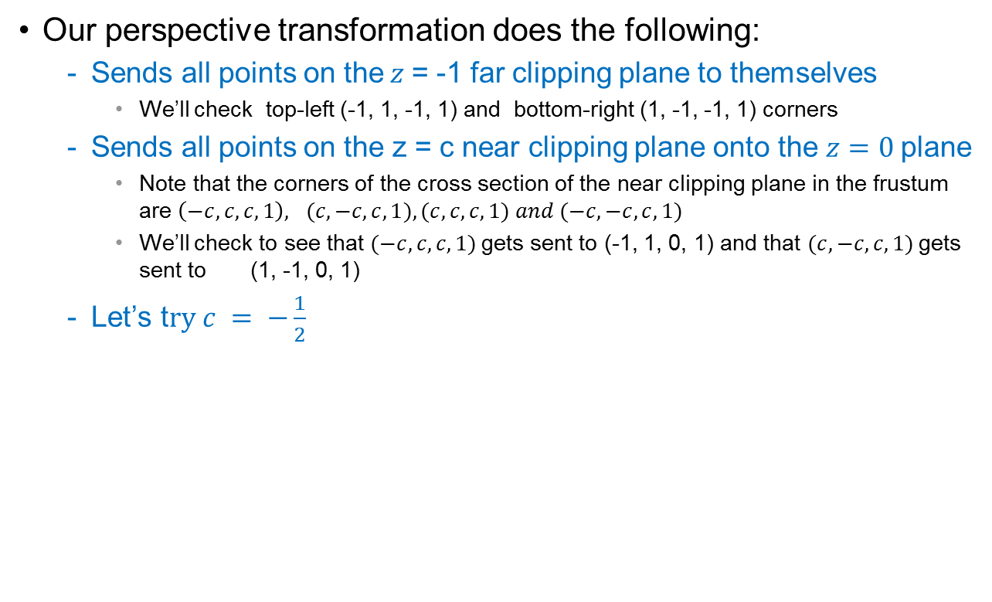


Unhinging View Volume to Become a Parallel View Volume(3/4)
$\left[\begin{matrix}1 & 0 & 0 & 0 \\ 0 & 1 & 0 & 0 \\ 0 & 0 & \frac{1}{c+1} & \frac{−c}{c+1} \\ 0 & 0 & −1 & 0\end{matrix}\right]$ =
$$\left[\begin{matrix}1 & 0 & 0 & 0 \\ 0 & 1 & 0 & 0 \\ 0 & 0 & 2 & 1 \\ 0 & 0 & −1 & 0\end{matrix}\right]$$

Slide 42

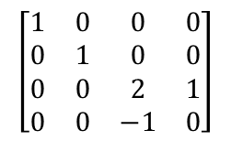
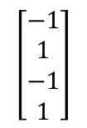
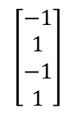
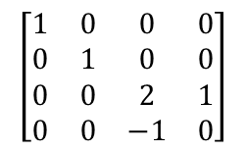
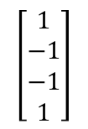
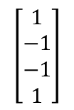
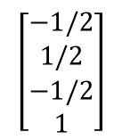
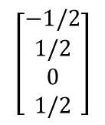
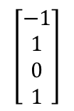
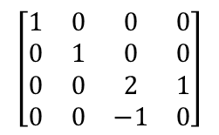
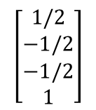
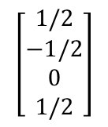
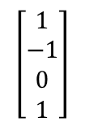
Unhinging View Volume to Become a Parallel View Volume(4/4)
Don’t forget to
homogenize!

Slide 43



The normalizing transformation (perspective)
=$\left[\begin{matrix}1 & 0 & 0 & 0 \\ 0 & 1 & 0 & 0 \\ 0 & 0 & \frac{1}{c+1} & \frac{−c}{c+1} \\ 0 & 0 & −1 & 0\end{matrix}\right]$

Slide 44


Why it works (1/2)
The key is in the unhinging step
We can take an intuitive approach to see this
The closer the object is to the near clipping plane, the more it is enlarged during the unhinging step
Thus, closer objects are larger and farther away objects are smaller, as is to be expected
Another way to see it is to use the parallel lines
Draw parallel lines in a perspective volume
When we unhinge the volume, the lines fan out at the near clipping
The result is converging lines, the railroad track

Slide 45

Why it works (2/2)
Yet another way to demonstrate how this works is to use occlusion (when elements in the scene are blocked by other elements)
Looking at the top view of the frustum, we see a square
Draw a line from your eye point to the left corner of the square, we can see that points behind this corner are obscured
Now unhinge the perspective and draw a line again to the left corner, we can see that all points obscured before are still obscured and all points that were visible before are still visible

